Slide 1
Polynomial
Regression Models
Polynomial regression models have two basic types of uses:
When the true curvilinear response function is really a polynomial function.
When the true curvilinear response function is unknown (or complex) but a polynomial function is a good approximation of the true function.
Polynomial models, especially higher order models, may provide good fits for the data but may turn in unexpected directions when extrapolated beyond the range of the data.

Slide 2
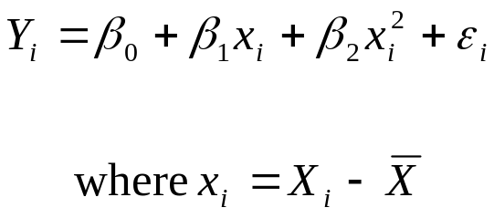
Polynomial
Regression Models
Polynomial models may contain, one, two, or several predictor variables and each predictor variable may be present in various powers.
We will first consider a polynomial model with one predictor variable raised to the first and second powers.
This polynomial model is called a second-order model with one predictor variable.

Slide 3

Polynomial
Regression Models
Note that the predictor variable is centered. It is expressed as a deviation around its mean X(bar) and the i^{th} centered observation is denoted by x_{i}
The reason for using a centered predictor variable in the polynomial regression model is that X and X² often will be highly correlated, which can cause serious problems.
Centering the predictor variable often reduces the multicollinearity substantially.
To reflect the pattern of the exponents, we will write the coefficients differently.

Slide 4
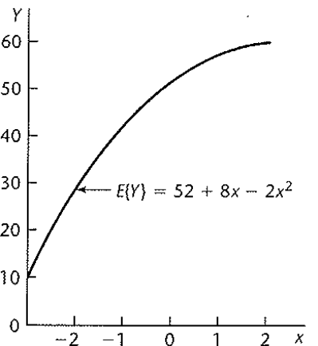
Polynomial
Regression Models
The response function is a parabola and is frequently called a quadratic response function.
An example of a second-order polynomial is pictured below. Note, if this function is extrapolated beyond x=2, it turns downward.
This might not be appropriate here and illustrates the danger in extrapolating a polynomial beyond the range of the data.

Slide 5
Polynomial
Regression Models
The regression coefficient β₀ represents the mean response of Y when x=0. Recall that x= X- X(bar), thus x=0 when X= X(bar) and β₀ is the mean response at the mean of the predictor variable.
This is another benefit of centering the data. Normally, β₀ is the mean response when the predictor is 0.
The coefficient β₁ is the linear effect coefficient and β₁₁ is the quadratic effect coefficient.
Polynomials can be extended to higher orders and to include multiple predictors but it is ideal to limit the model to a third order if at all possible, and generally no more than a fifth-order model.

Slide 6

Polynomial
Regression Models
Typically when fitting a polynomial model, we check to see if a lower order model is adequate.
Suppose we have a third-order model with one predictor
We may wish to see if a quadratic model is sufficient, that is we would test H_{o}:β₁₁₁ = 0.
The appropriate extra sums of squares for this test is SSR(x³|x,x²).

Slide 7
Polynomial
Regression Models
To test if a linear model is adequate, we would test H_{o}:β₁₁= β₁₁₁= 0.
In this case, the appropriate extra sum of squares is SSR(x²,x³|x)= SSR(x²|x) + SSR(x³|x, x²).
If a polynomial term of a given order is kept in the model, then all related terms of lower order are also kept in.
For example, one would not drop the quadratic term but retain the cubic term.
The lower order terms provide more basic information about the shape while the higher order terms provide refinements. Thus it makes no sense to include the higher order term and not the lower order terms.

Slide 8
Interaction
Interaction between two predictor variables is present when the effect on the response variable of one predictor depends on the value of the other.
For example, suppose we are interested in the effects that gender and a new medicine have on blood pressure.
A model without interaction would mean that the effect of medicine is the same for both genders.

Slide 9
Interaction
An interaction model might show that men on the new medicine tend to have lower blood pressure than men on a control.
However, women on the new medicine tend to have the same blood pressure as women on the control.
The effects of the new medicine in this case depend on the gender. The medicine works for men but not for women.
The regression model for two quantitative predictors with interaction, represented by a cross-product term is:

Slide 10
Interaction
The meanings of the regression coefficients β₁ and β₂ are not the same as with a model without interaction.
For example, β₁ no longer indicates the change in the mean response for a unit increase in X₁, given that X₂ is held constant.
Instead, the change in the mean response for a unit increase in X₁, given that X₂ is held constant, is given by
β₁ + β₃X₂
Looking at the model both β₁ and β₃X₂ are multiplied by X₁, thus for every additional unit of X₁ not only is there an additional β₁ but also an additional β₃X₂.

Slide 11
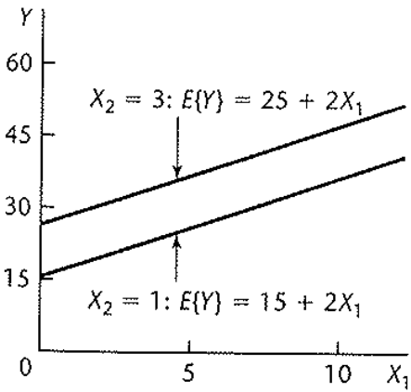
Interaction
Consider a sales promotion model where locality sales (Y) is modeled as a function of point-of-sale expenditures (X₁) and TV expenditures (X₂).
The model is additive: E{Y} = 10 + 2X₁ + 5X₂
The figure below shows the response function E{Y} as a function of X₁ when X₂ =1 and when X₂ =3. The two response functions are parallel. The mean response has slope β₁ = 2 for both X₂ =1 and X₂ = 3.

Slide 12
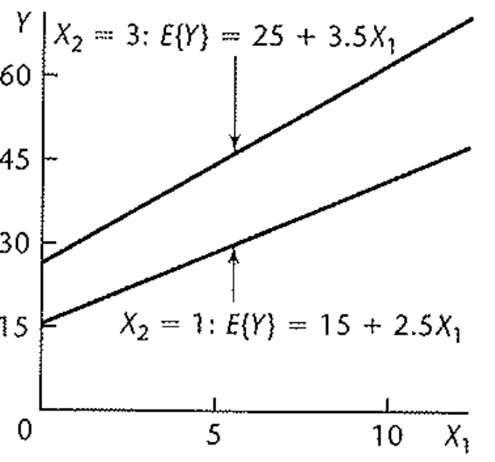
Interaction
Now consider a model with interaction.
E{Y} = 10 + 2X₁ + 5X₂ + .5X₁X₂
The figure below shows the response function E{Y} as a function of X₁ when X₂ =1 and when X₂ =3. Now the slopes of the response functions are different.

Slide 13
Interaction
The slope of the response function when X₂= 1 is
β₁ + β₃ X₂ = 2+ .5(1) = 2.5
The slope of the response function when X₂= 3 is
β₁ + β₃X₂ = 2+ .5(3) = 3.5
Thus, a one unit increase in X₁ has a larger increase on the response when X₂ is at a higher level than when X₂ is at a lower level.
If β₃ where negative, then a one unit increase in X₁ would have a larger increase on the response when X₂ is at a lower level than when X₂ is at a higher level.

Slide 14
Interaction
When there was no interaction in the model, only the intercept of the mean response changed for different levels of X₂
With the interaction in the model, although the response function is still linear, both the intercept and slope change for different levels of X₂
When interaction terms are added to the model, high multicollinearities may exist between the predictors and some of the interaction terms, as well as among some of the interaction terms themselves.
To adjust for this, we center the predictor variables. Thus, for the k^{th} predictor we use x_{ik} = X_{i} – X_{k}(bar) in the model.

Slide 15
Interaction
When the number of predictor variables in the regression model is large, there are several potential interactions that can be included.
For example, if there are 8 predictor variables, there are 28 potential pair-wise interactions.
To include 36 predictors, we would have to have a very large dataset.
Therefore, it is advantageous to identify in advance what interactions are most likely to influence the response variable in important ways.

Slide 16
Interaction
Recall the body fat example, where we have 3 predictors. We will test formally whether interaction terms between these predictors need to be included.
We will consider the following model
After obtaining the new interaction variables X₁X₂, X₁X₃, and X₂X₃, we find that some of the predictor variables are highly correlated with some of the interaction terms and there are some high correlations among the interaction terms.
For example, the correlation between X₁ and X₁X₂ is .989 and the correlation between X₁X₃ and X₂X₃ is .998

Slide 17
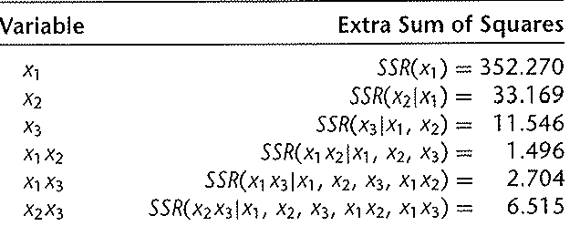
Interaction
Therefore we will use centered variables in the model.
The correlations are now smaller. For example, the correlation between X₁X₃, and X₂X₃ goes from .998 to .891.
After fitting this model the MSE is 6.745 and the table of Extra Sums of Squares is listed below.

Slide 18
Interaction
To test if any of the interaction term are needed, the null is
H_{o}: β₄ = β₅ = β₆ = 0
The partial F statistic here requires the following extra sum of squares
SSR(x₁ x₂, x₁x₃, x₂x₃| x₁,x₂,x₃) =
SSR(x₁x₂| x₁,x₂,x₃) + SSR(x₁x₃| x₁, x₂, x₃, x₁x₂) + SSR(x₂x₃| x₁, x₂, x₃, x₁x₂, x₁x₃)
=1.496 + 2.704 + 6.515 = 10.715

Slide 19
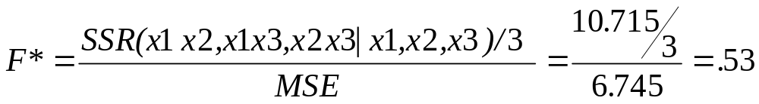
Interaction
The test statistic is:
For α = .05, we require F(.95,3,13) = 3.41 for our results to be significant.
Thus we do not reject the null and conclude that the interaction terms are not needed in the model.
The numerator degrees of freedom comes from p-q, where here p is 7 corresponding to the 7 β’s in the full model, and q is 4, corresponding to the 4 β’s left in the reduced model. (SAS – interaction)

